Slide 1
Data Splash / Region-aires!

Slide 2
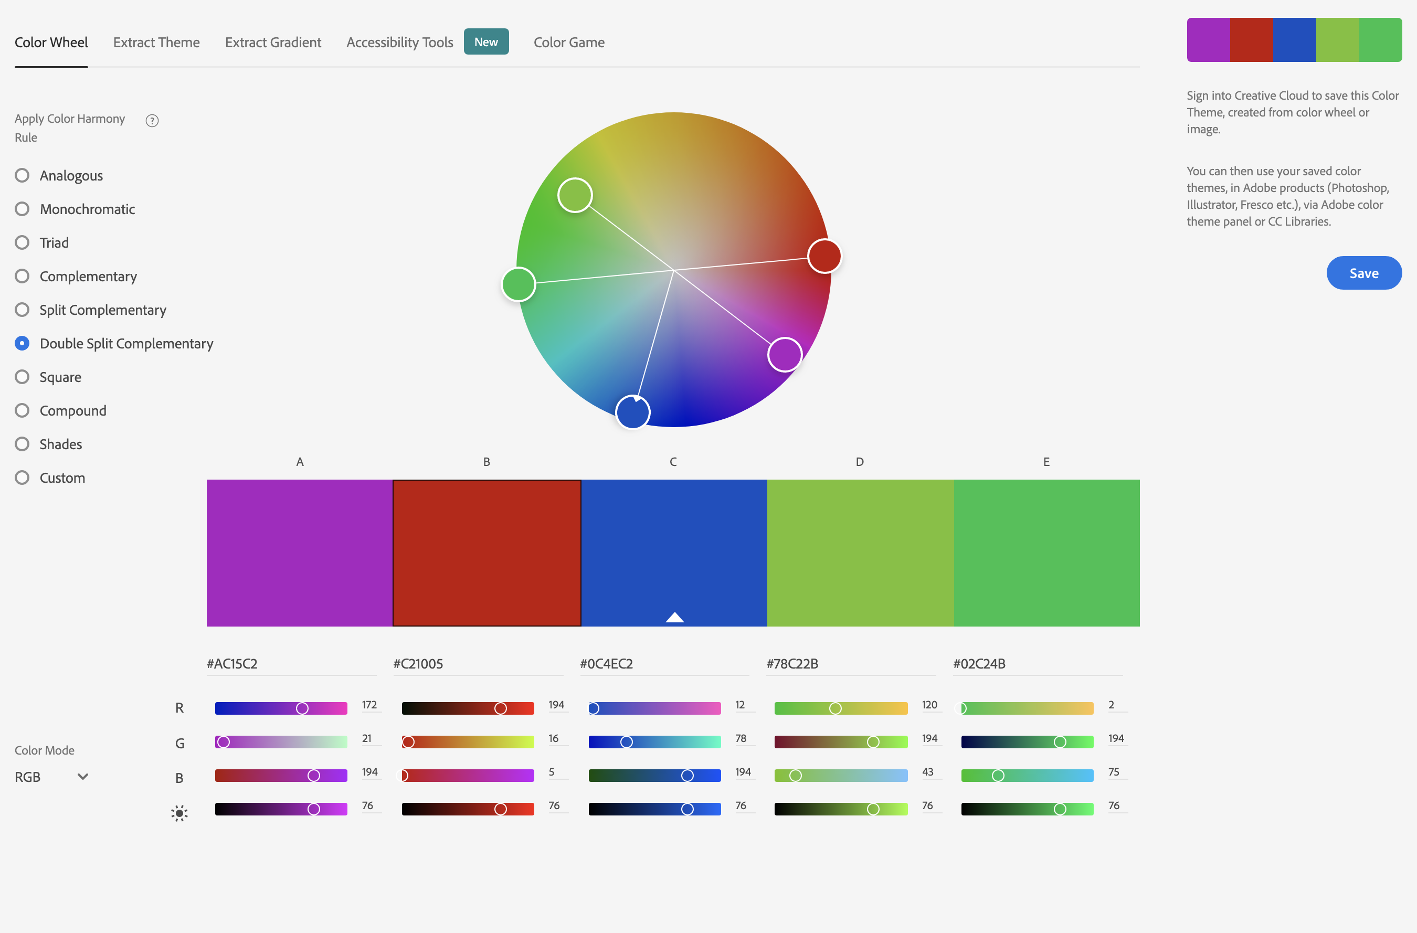
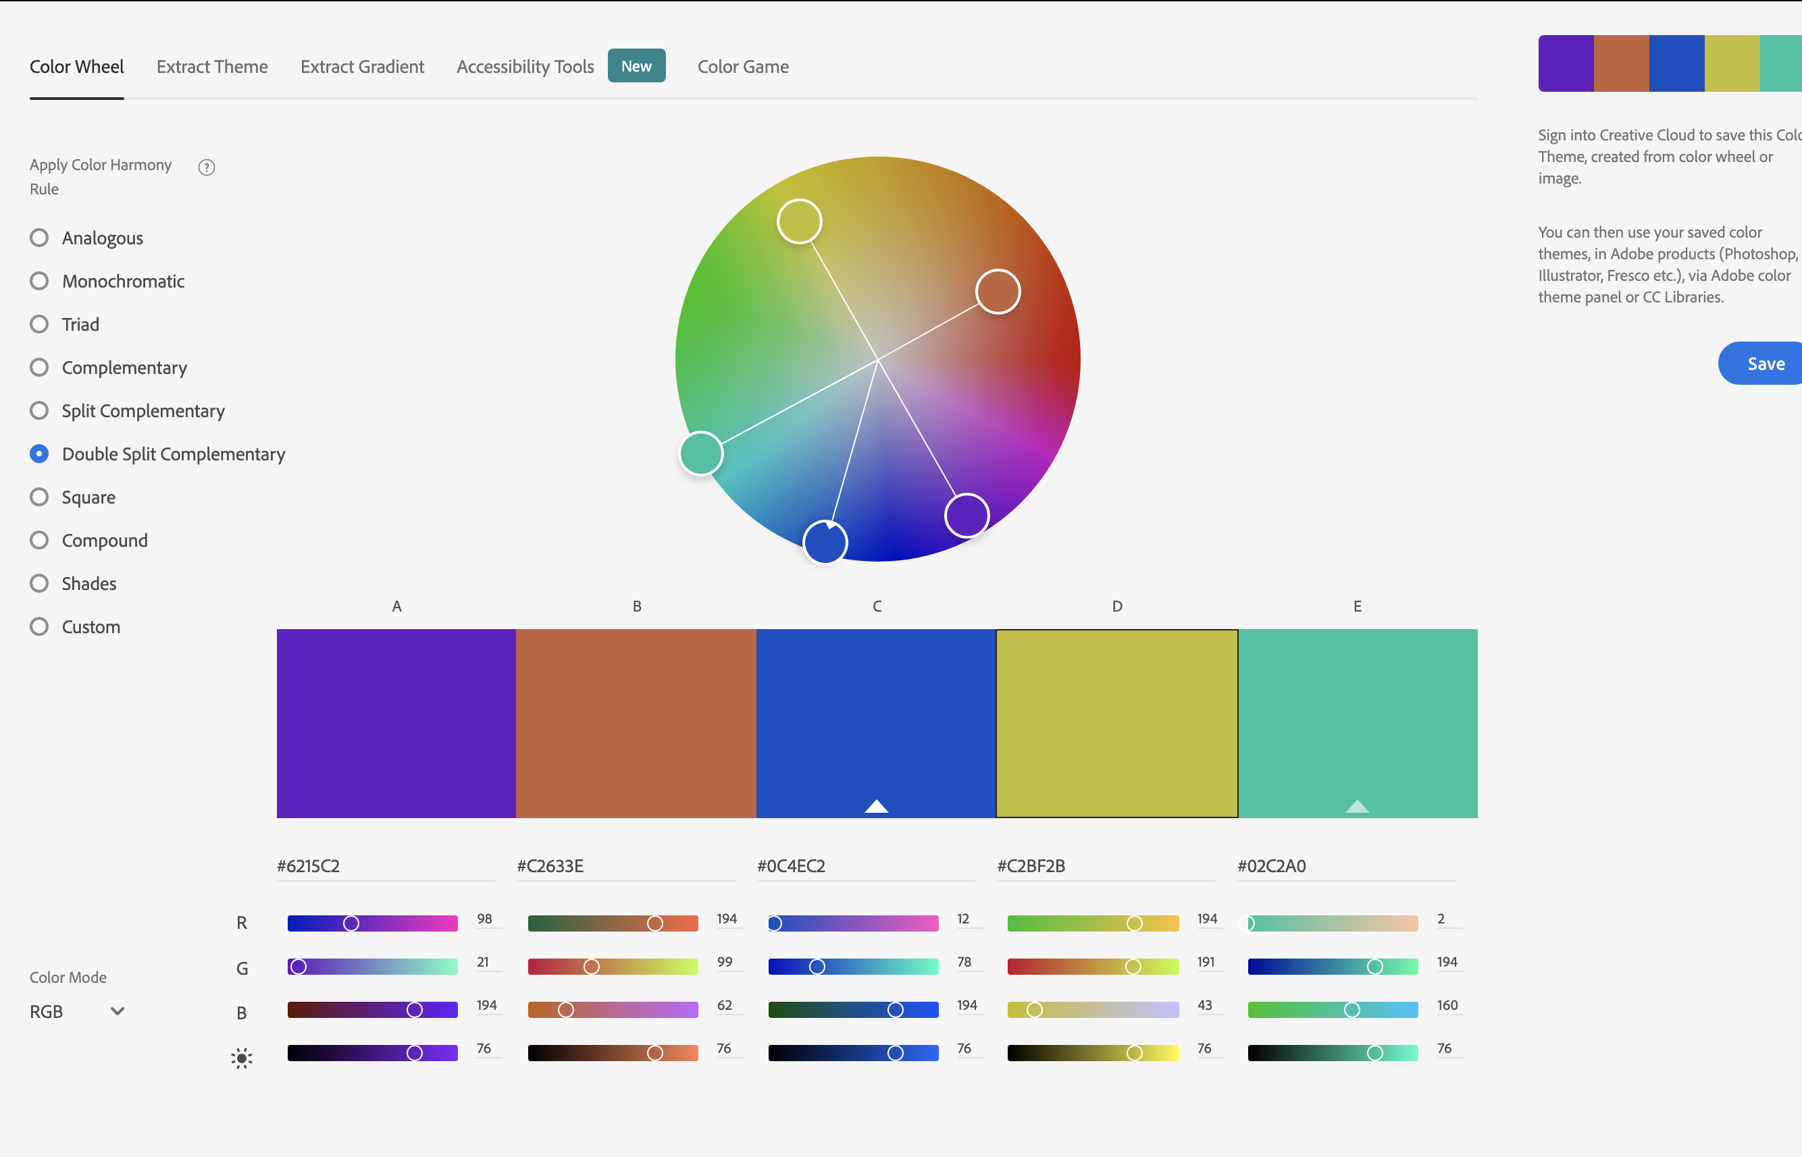
Colour Scheme

Slide 3

Splash Screen
Data
Splash!

Slide 4
Main Menu
Main
Menu!
Select an option:
Play
Learning Zone
Free Play
Awards Zone

Slide 5
Pre-Game Screen
Linear
Regression!
Animated Image of how to interact
With game world.
Instructions
Explanation of how to interact with the gamev
How to Win!
Explanation of how to win the game

Slide 6
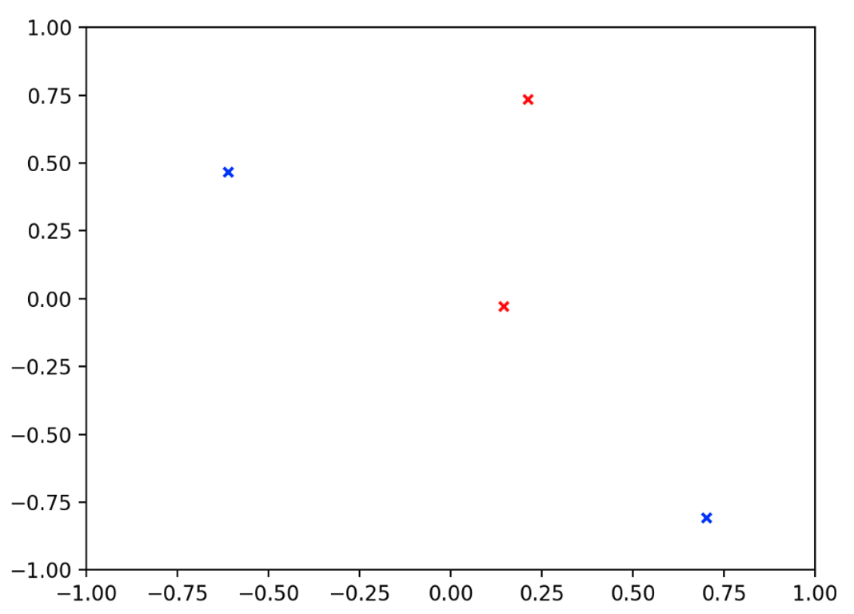
Game Screen
Linear
Regression!
Aim:
You must complete the challenge – description here!
Score: P1 – 200 | P2 – 300
Current Moves:
P1: P2:
X, y 1. X, y
X, y 2. X, y
X, y 3. X, y
Player % Turn!
Tip:
Tip of how the algorithm works.
Notes:
K-Means will need to have an option for the play to guess how many centroids there is.

Slide 7



Learning Zone (Web Browser)
Free -

Slide 8
Free Play Area
Free
Play!
Select a Model you want to explore:
Linear Regression
K-Means
SVM
Support Vector Machine
GMM
Gaussian Mixture Model
Home

Slide 9

Free Play Area
Model/ Interaction Area
Model: [Name]
Learning Type: [Supervised/ Unsupervised]
Overview: [Brief overview of the model]

Slide 10
Awards Screen (Gamification Badges)
Awards
Zone!
List of all the available awards.
Leader board/ High score area
*Pop-up window*
Explanation of how to get them/ a snippet of the award if won

Slide 11
Credits Screen? Maybe?
List resources/books/ lecture slides that content was taken from?
Coming
Soon!

Slide 12
Game Screen
nd
a
Coming
Soon!
Aim:
You must complete the challenge – description here!
Principal Component Analysis
Score: P1 – 200 | P2 – 300
Current Moves:
P1: P2:
X, y 1. X, y
X, y 2. X, y
X, y 3. X, y
Player % Turn!
Tip:
Tip of how the algorithm works.
Notes:
K-Means will need to have an option for the play to guess how many centroids there is.

